Slide 1
Water Prospective between
REALITY & Solution in Egypt
10 April 2011 -Water Prospectives between Realialty and Solution- Dr. Sherif Shawky
Sherif M Shawky , PhD

Slide 2

Water

Slide 3
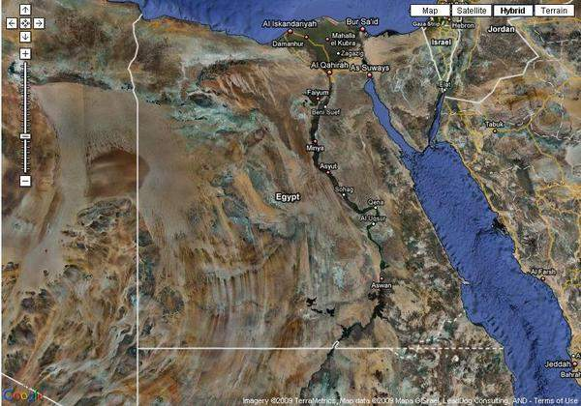

Slide 4
NILE RIVER
Nile basin countries
Current Situation
Agreements
Contingency Center
The Plan

Slide 5
Nile basin countries
Burundi Tanzania
Congo Kenya
Rwanda Uganda
Eretria Sudan
Egypt Ethiopia

Slide 6
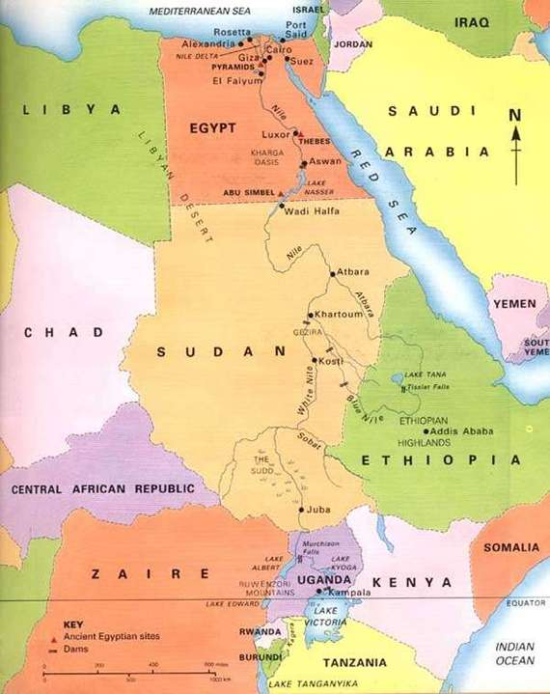

Slide 7
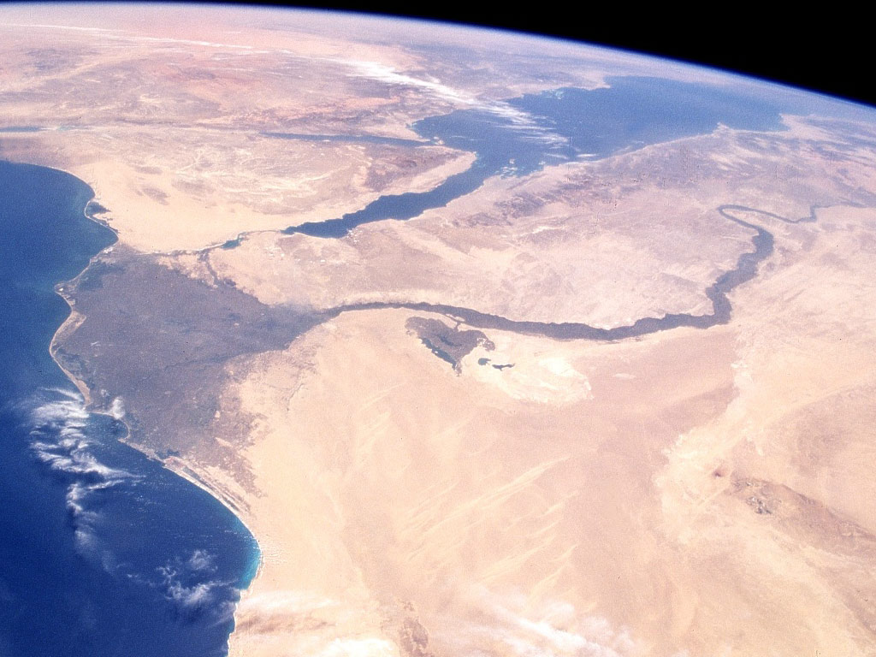
The River Nile

Slide 8
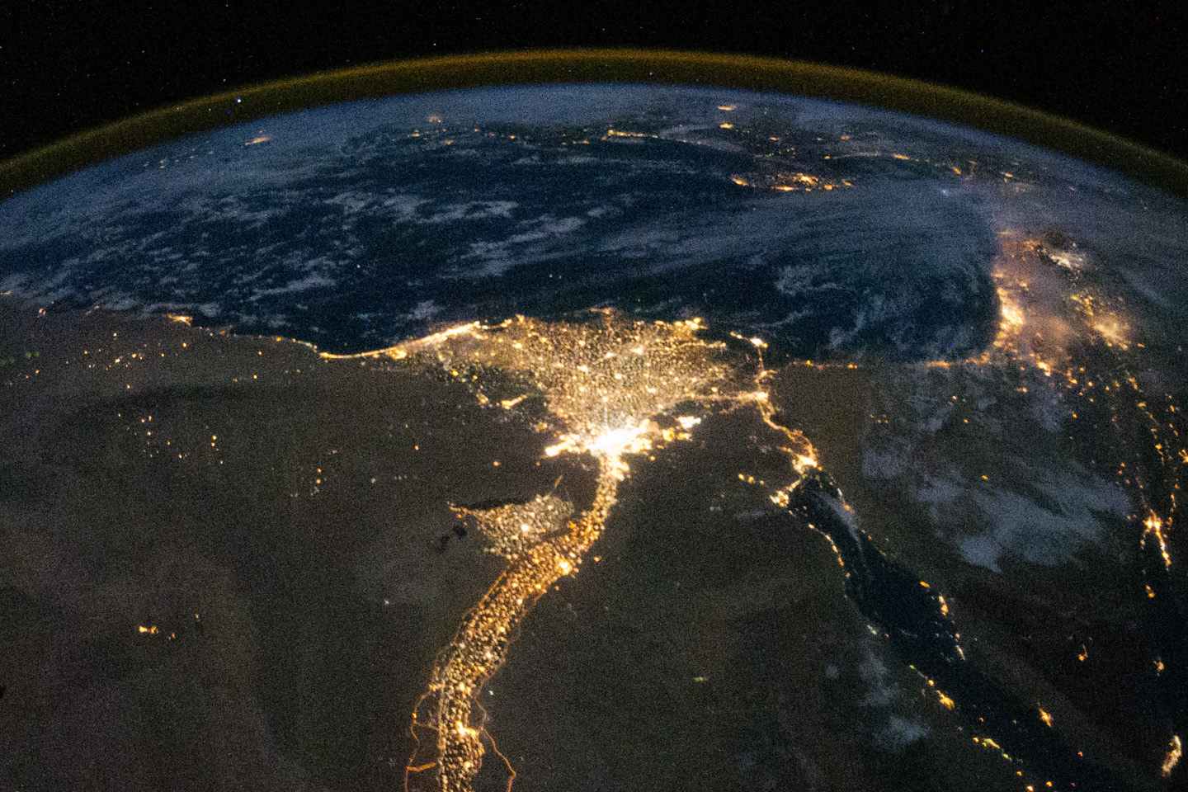
The River Nile

Slide 9
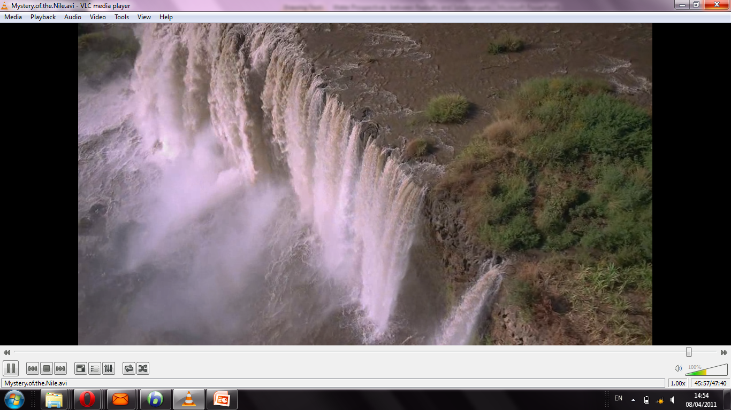

Slide 10
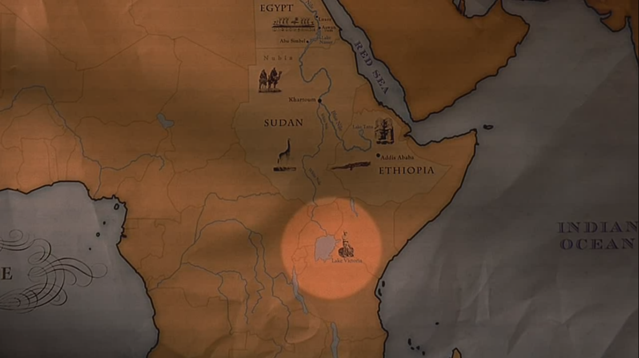
Lake Victoria 20%

Slide 11
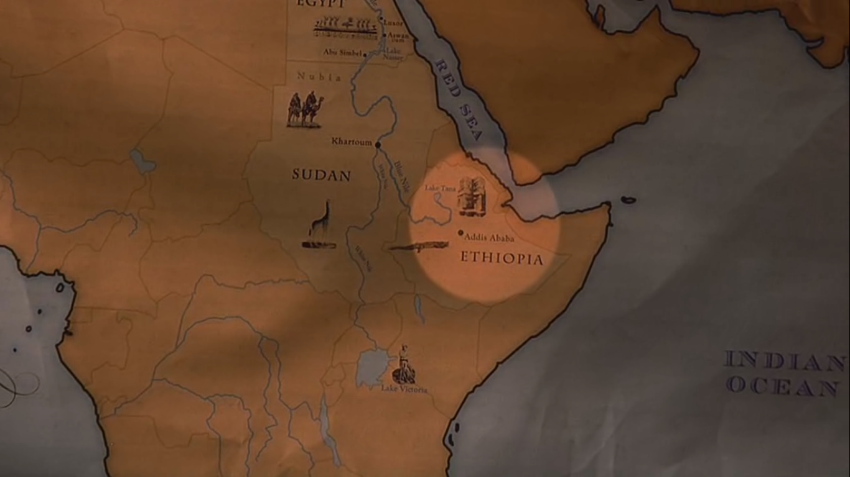
Blue Nile 80% ‘Ethiopia’

Slide 12
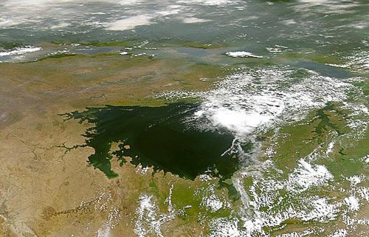
Lake Victoria : Kenya

Slide 13
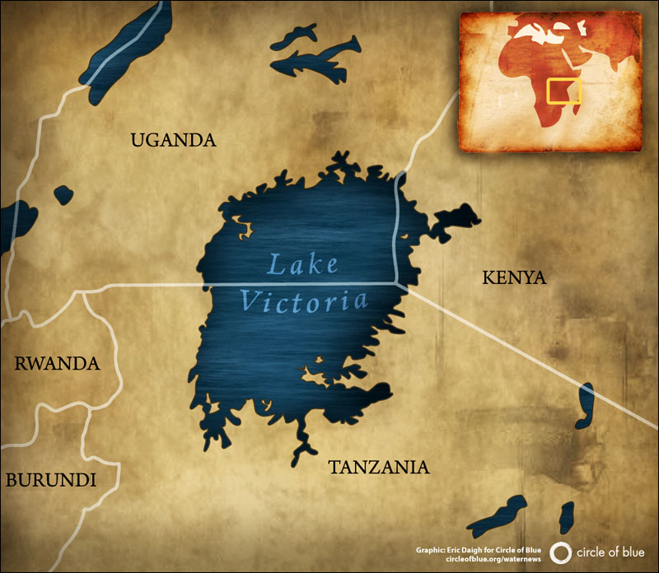

Slide 14
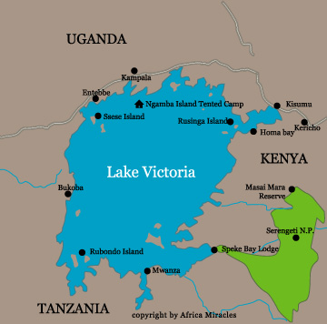

Slide 15
LAKE TANA ETHIOPIA
Blue Nile 80%

Slide 16
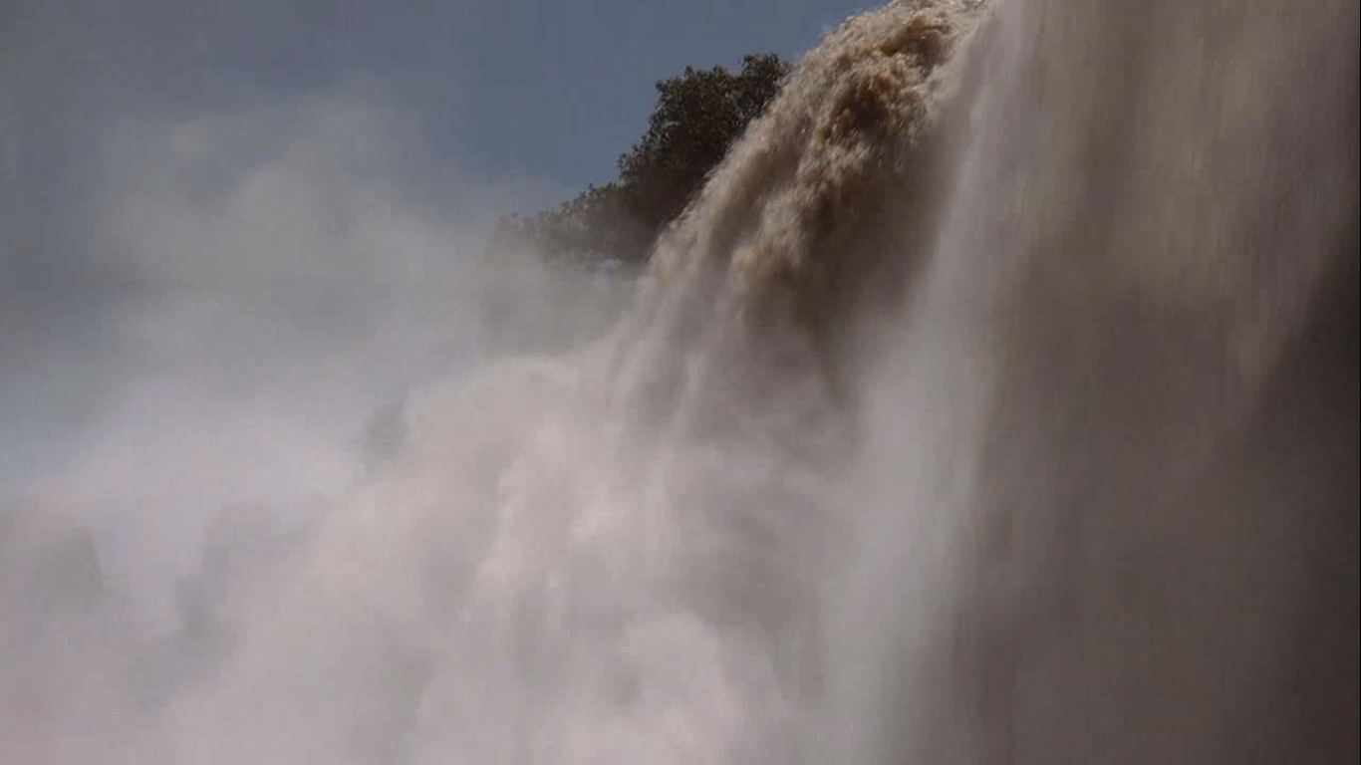

Slide 17
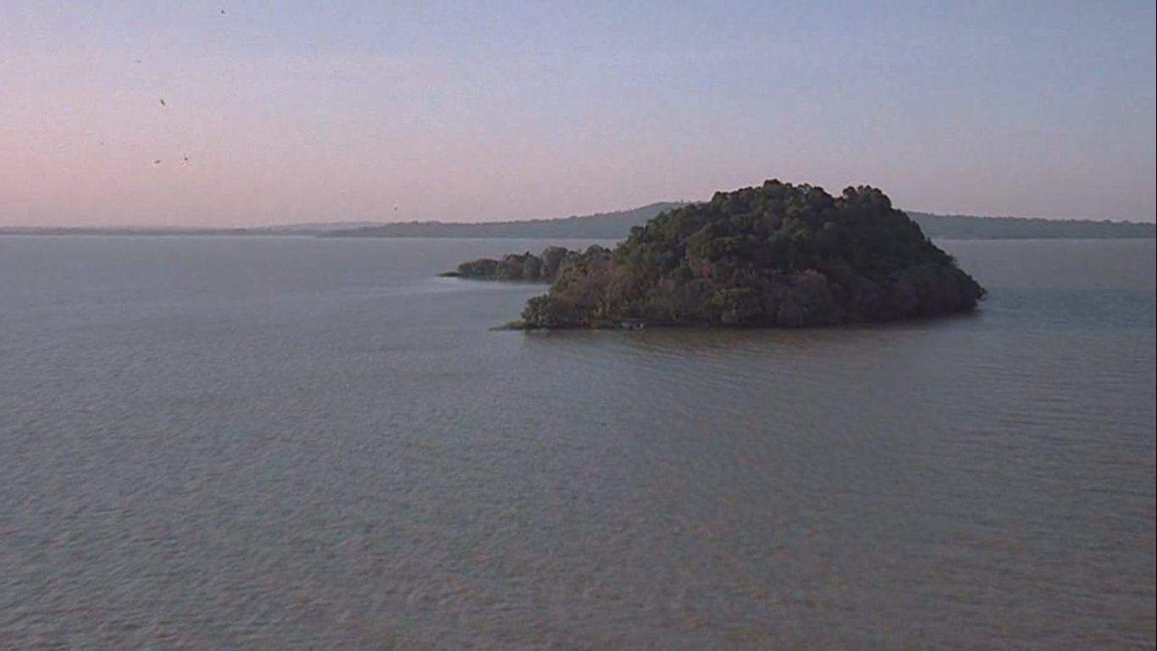

Slide 18


Slide 19
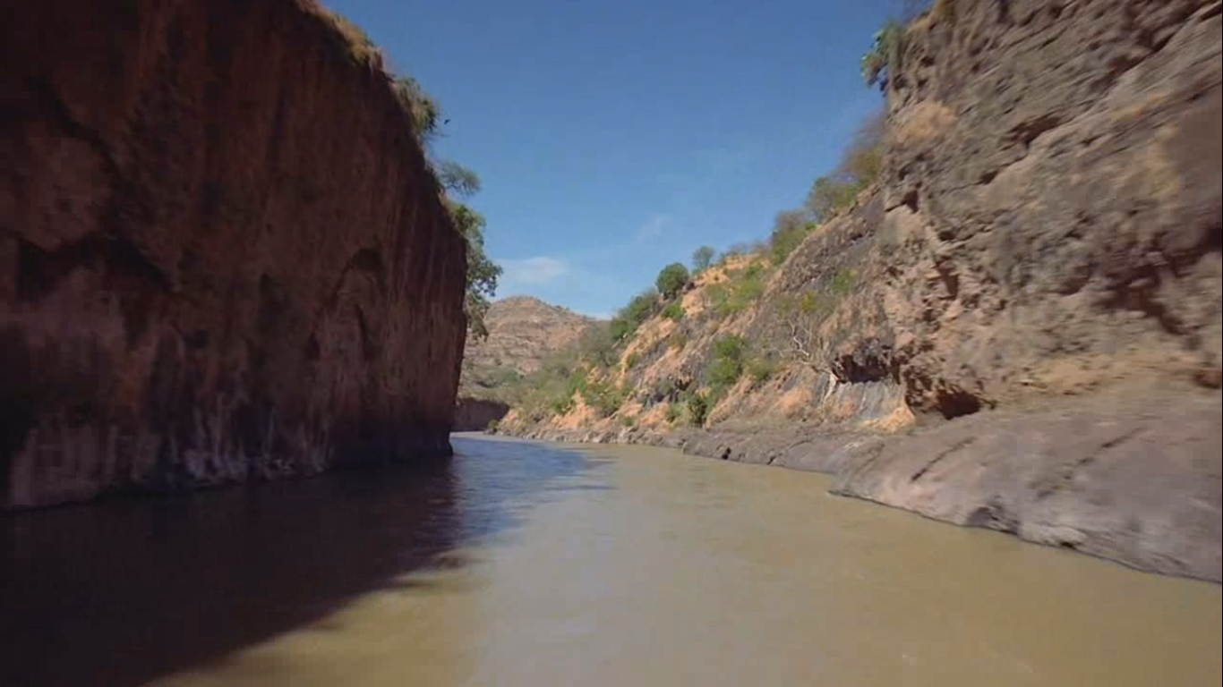

Slide 21
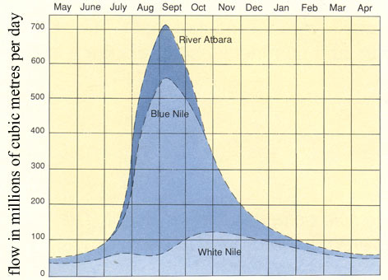

Slide 22
NILE RIVER
Nile basin countries

Slide 23
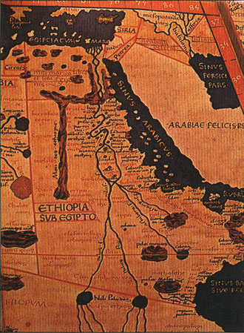

Slide 25
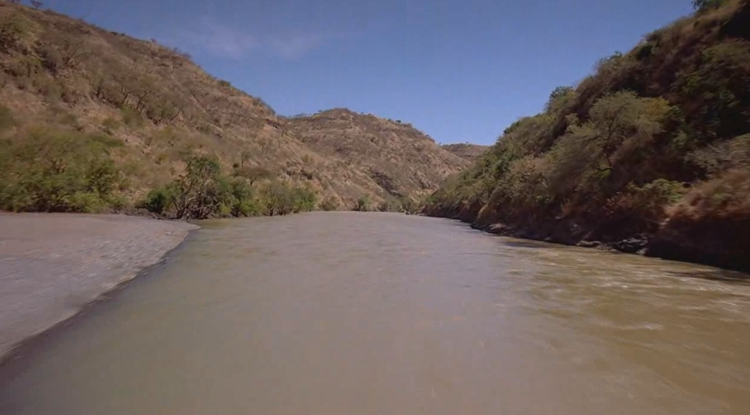
NILE RIVER
2 . Current Situation

Slide 26
The individual's average share of fresh water reached
800 cubic meters annually

Slide 27
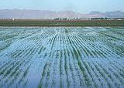

Slide 28
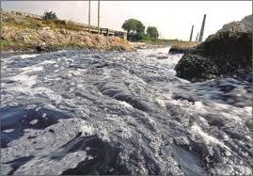

Slide 29
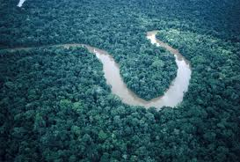

Slide 30
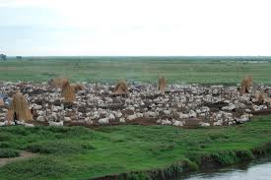

Slide 31
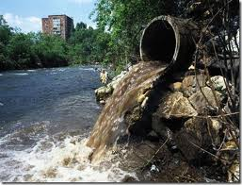

Slide 32
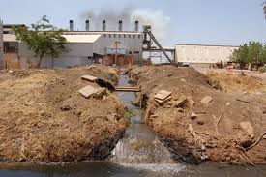

Slide 33
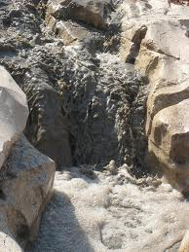

Slide 34
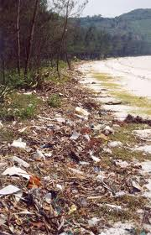

Slide 35
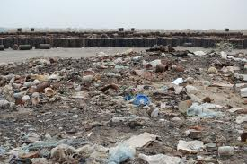

Slide 36
Population
Egypt Population density
Population across the last century
Prospective of population Growth

Slide 37
The River Nile

Slide 38
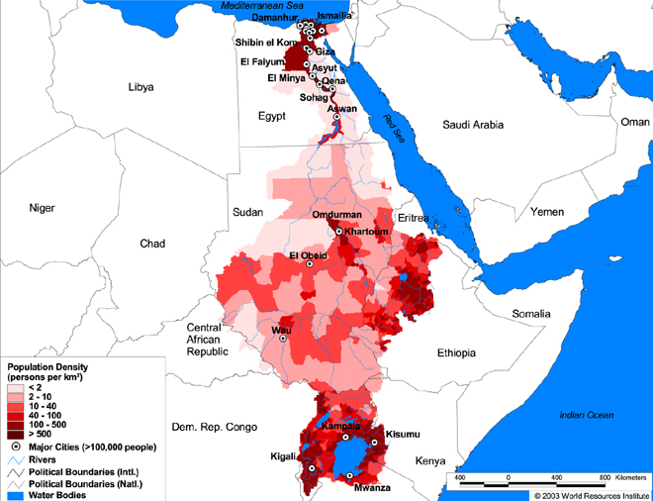

Slide 39
Country | Population Growth % | Population 2007 (millions) | Projected Population 2025 (millions) | Per capita water availability 1990 (cubic meters) | Per capita water availability 2025 (cubic meters)
Egypt | 1.7% | 80.3 | 109.2 | 1,123 | 630
Sudan | 2.1% | 39.3 | 56.9 | 4,792 | 1,993
Ethiopia | 2.8% | 76.5 | 114.6 | 2,207 | 842
Uganda | 3.6% | 30.2 | 56.8 | 3,759 | 1,437

Slide 40
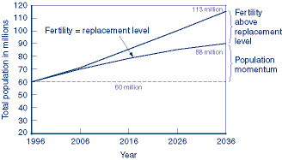

Slide 41
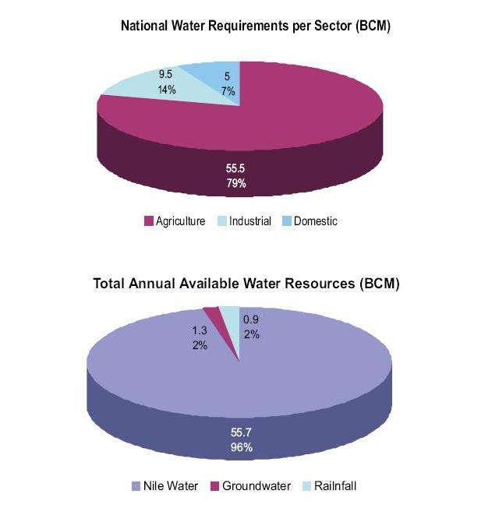

Slide 42

3 .Agreements

Slide 43
2 .Agreements
1929 …………………….. 1925
1959
        1989
1999 Nile Basin Initiative

Slide 44

2010 Agreement Draft

Slide 45
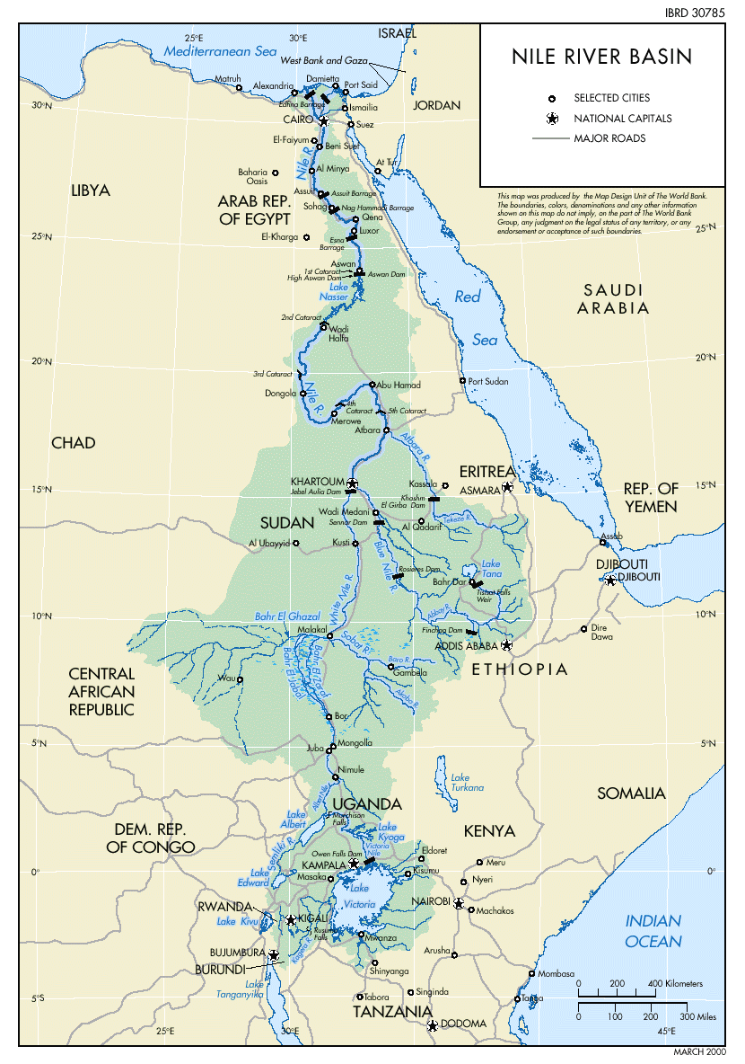

Slide 46
Nile basin countries
Burundi Tanzania
Congo Kenya
Rwanda Uganda
Eretria Sudan
Egypt Ethiopia

Slide 47
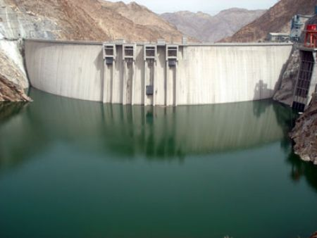
The Tekeze Dam project in Ethiopia

Slide 48
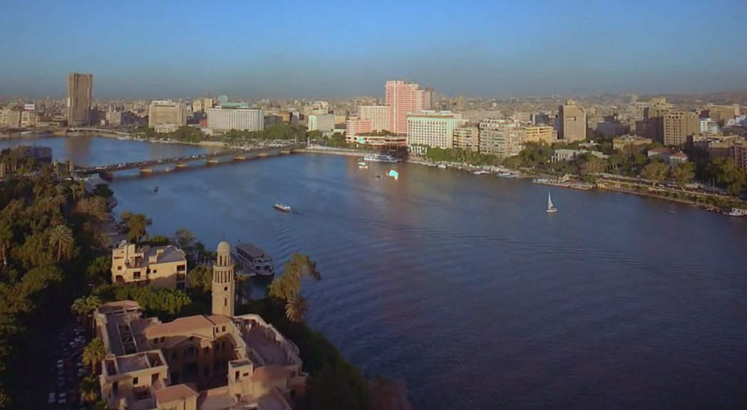
4 .Contingency Center

Slide 49
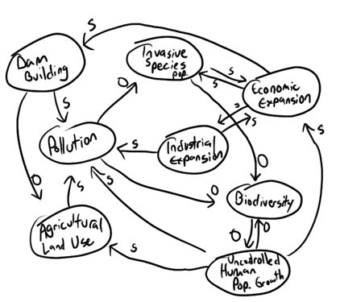

Slide 51

5 . The Plan

Slide 52
Agriculture
Flooding irrigation
Modern Irrigation
“ spraying dripping irrigation”

Slide 53
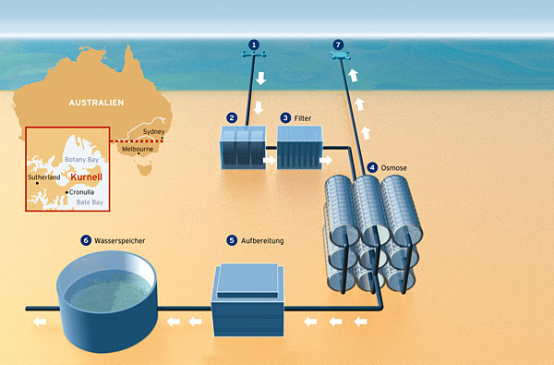

Slide 54
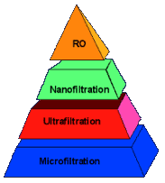
Desalination Theory

Slide 55
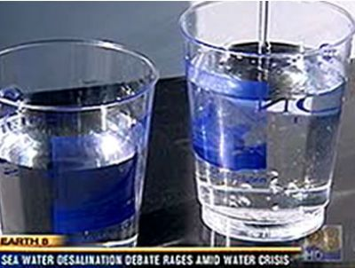

Slide 56
Thank You sherifshawky2000@yahoo.com

Slide 57
Water Prospective between
Reliably and Solution in Egypt
Sherif M Shawky , PhD

Slide 58
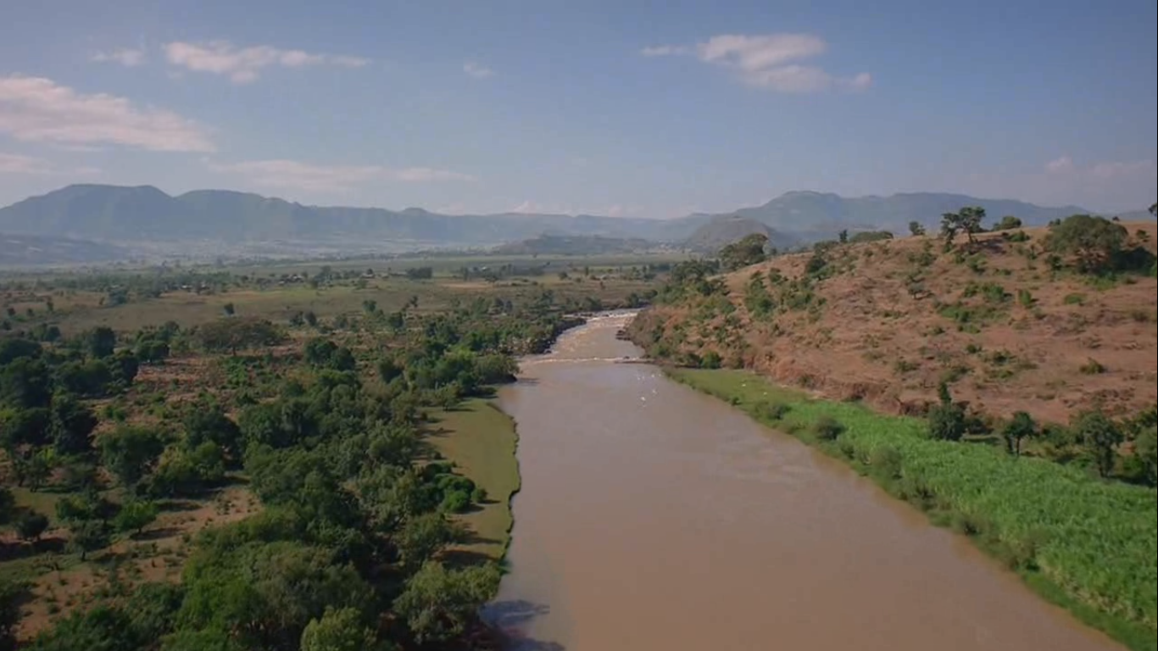
The River Nile

Slide 59
TEAM Of The Proposed Center
COORDINATOR
RIVERS’ SPECIALIST
GEOGRAPHICAL CONSULTANT
REMOTE SENSING SPECIALIST
RIVER HYDRULIC SPECIALIST
AGRICULTRUAL SPECIALIST
    UNDERGROUNDWATER SPECIALIST
    WATER DESALINATION SPECIALIST
BIOLIFE CONSULTANT
WATER MANAGEMENT SPECIALIST
POLLUTION CONTROL SEPCIALIST

Slide 60
HYDROPOWER SPECIALIST
INTERNATIONAL LAW SPECIALIST
BIOSTATISTICAL SEPCIALIST
Global Warming Specialist
Environmental Economist
Demography Specialist
Epidemiology Consultant
Cooperation with Dr. Al Baaz , NASA

Slide 61
THE PLAN
Phase I:
Assessment Phase …………….. 4 M
Preliminary Draft ……………….. 5 M
Final Draft …………………………6 M
Phase II
Implementation Phase ………….. 12 M
Follow up
Phase III
Post Assessment Phase ………… 18
Continuous Supervion and Logistic Support ….

Slide 62
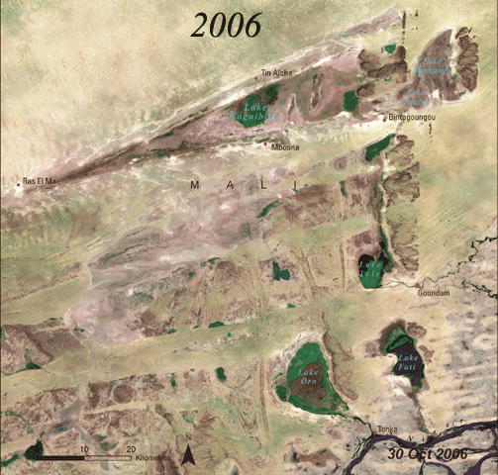
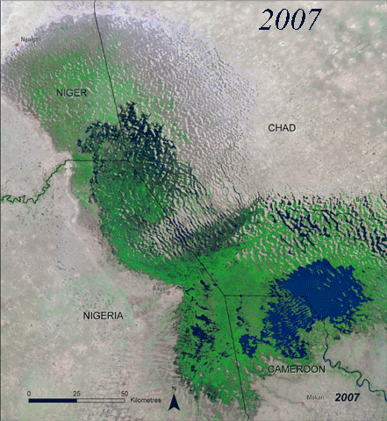
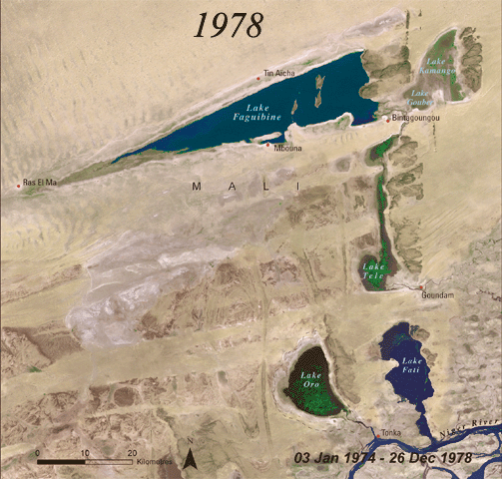
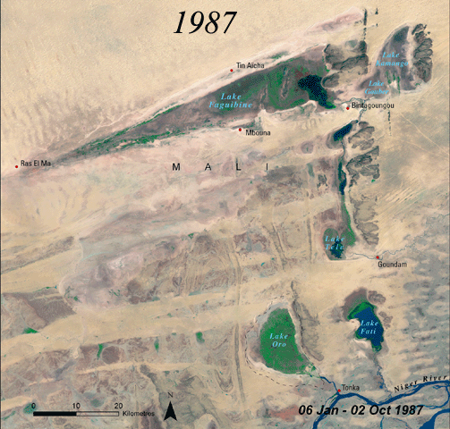
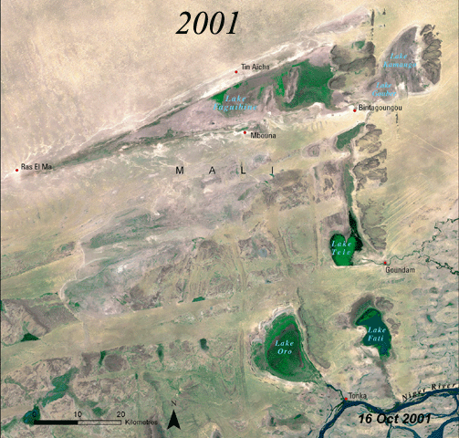
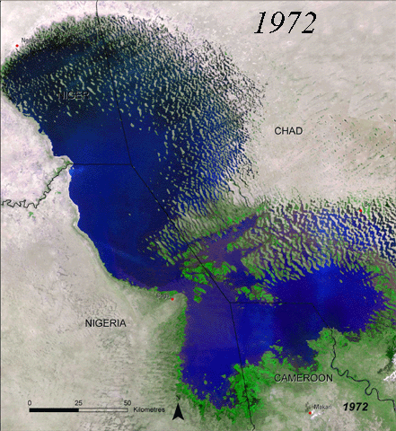
Drought in Africa
Lake Faguibine
Lake Chad
Notes:
Africa's drought troubles began well before greenhouse gases increased to any appreciable degree. The inhabitants of Northern Africa have systematically cut down trees for firewood for thousands of years. The result has been that transpiration has decreased, decreasing rainfall and expanding the Sahara Desert. Similar deforestation is now occurring over much of Africa. The result is that the deserts of North, South and East Africa are expanding, leading to drought. Coupled with global warming induced changes in precipitation, it is likely that the peoples of much of Africa will be suffering from drought and starvation in the coming decades.

